Slide 1
Assignment
EDA REPORT
Made by –
RASHIKA KHANDELWAL
mail Id - rashika.khandelwal225@gmail.com

Slide 2
Exploratory Data Analysis Report
The original dataset contains a distribution of 24.08% entries labeled with >50k and 75.92% entries labeled with <=50k. We split the dataset into training and test sets while maintaining the above distribution. The following graphs and statistics pertain to the training set.
Label | Number | Percentage
<= 50k | 24720 | 75.92
> 50k | 7841 | 24.08
To gain insights about which features would be most helpful for this assignment, we look at the feature and the distribution of entries that are labeled > 50k and <= 50k. We do this in hopes to identify features that provide little information in order to simplify our model’s complexity and runtime.

Slide 3
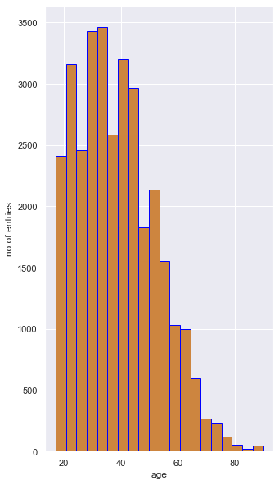
Age distribution

Slide 4
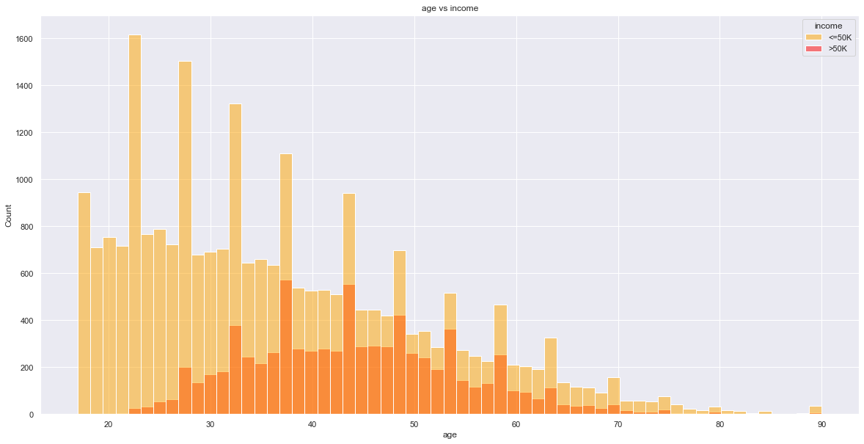
Fig shows the age distribution among the entries in our dataset. The ages range from 17 to 90 years old with the majority of entries between the ages of 25 and 50 years.

Slide 5
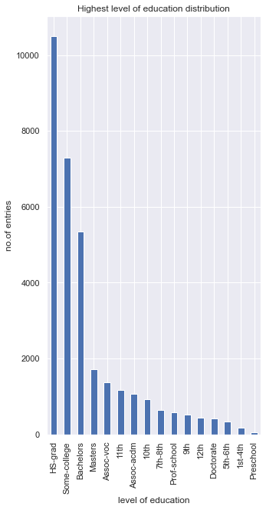
Highest level of education distribution
Figure shows the distribution of the different levels of education among individuals in the dataset.Most of the individuals in the dataset have at most a high school education while only a small portion have a doctorate. We think this is a fair representation.

Slide 6
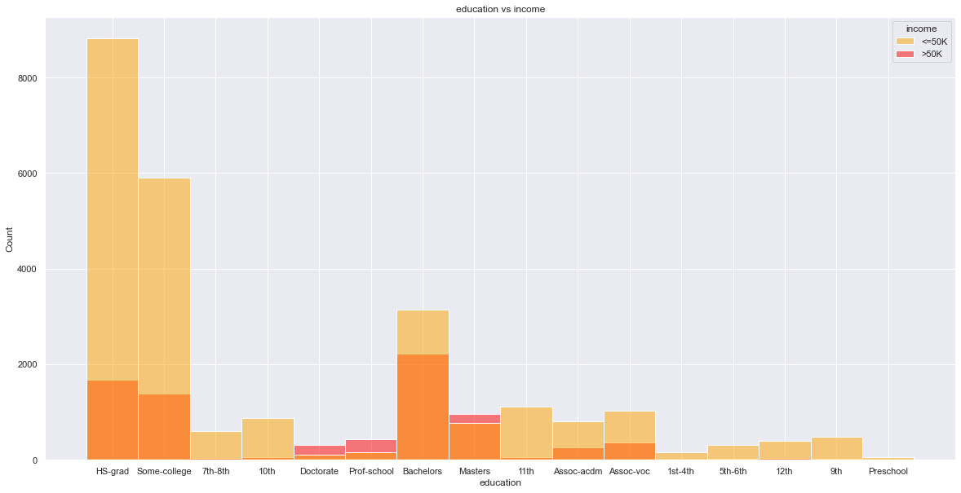
Fig shows the relationship between the highest level of education and the number of people labeled >50k and <=50k.For the most part, a higher level of education is correlated to a higher percentage of individuals with the label >50k. One interesting statistic to note is the ratio of individuals labeled >50k to <=50k is almost the same between those that have a doctorate and those that went to a professional school (Prof-school).

Slide 7
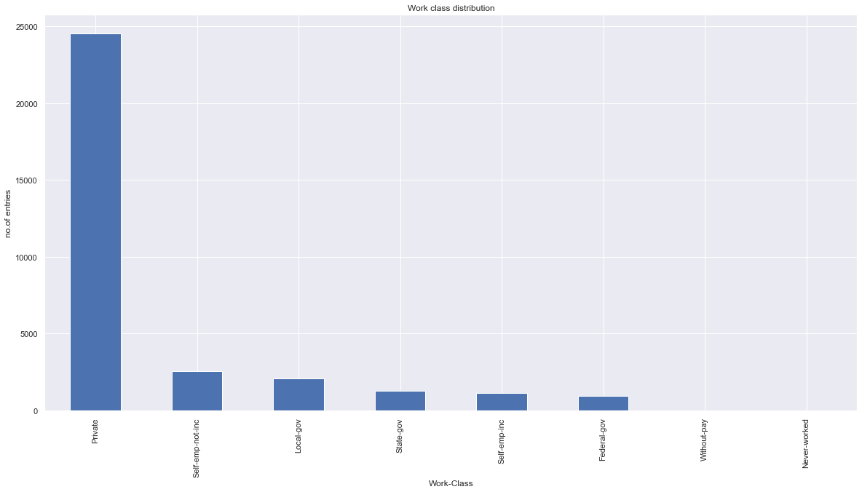
Work class distribution
Fig above depicts that the majority of the individuals work in the private sector.The probabilities of making >50K are similar among the work classes except for self-emp-inc and federal government. Federal government is seen as the most elite in the public sector, which most likely explains the higher chance of earning >50K. Self-employed-incorporated implies that the individual owns their own company , which means earnings >50K.

Slide 8
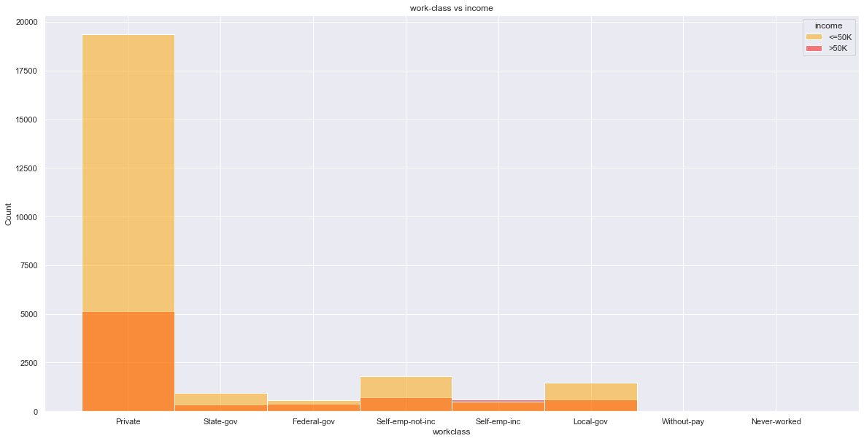

Slide 9
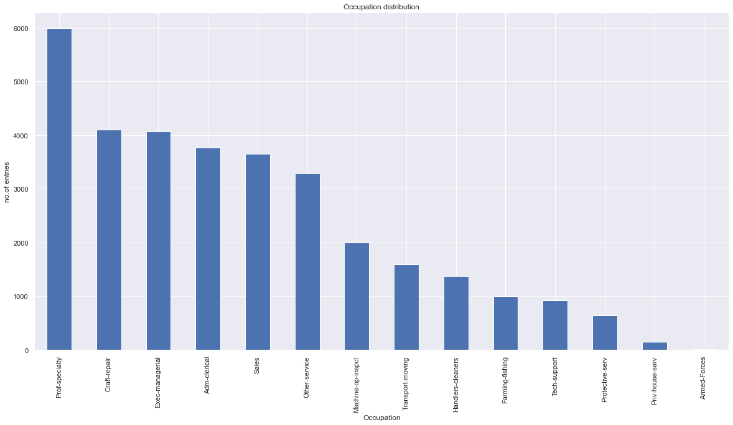
Occupation Distribution
In above fig,there is a somewhat uniform distribution of occupations in the dataset, disregarding the absence of Armed Forces.

Slide 10
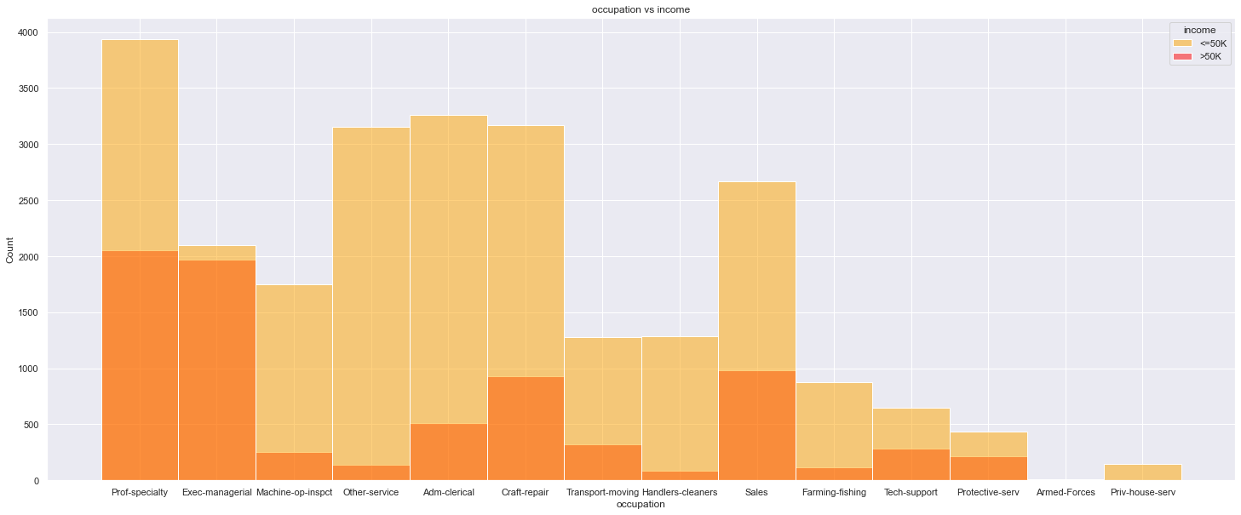
However, looking at above Figure Occupation vs Income, exec-managerial and prof-specialty stand out as having very high percentages of individuals making over >50K. In addition, the percentages for Farming-fishing, Other-service and Handlers-cleaners are significantly lower than the rest of the distribution.

Slide 11
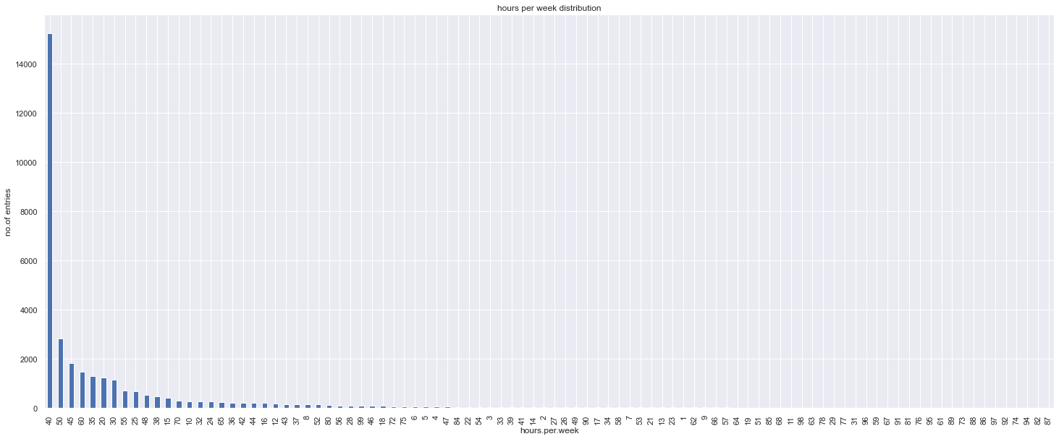
hours per week distribution
Fig depicts ,the vast majority of individuals are working 40 hour weeks which is expected as the societal norm. Regardless of the nonuniform distribution.

Slide 12
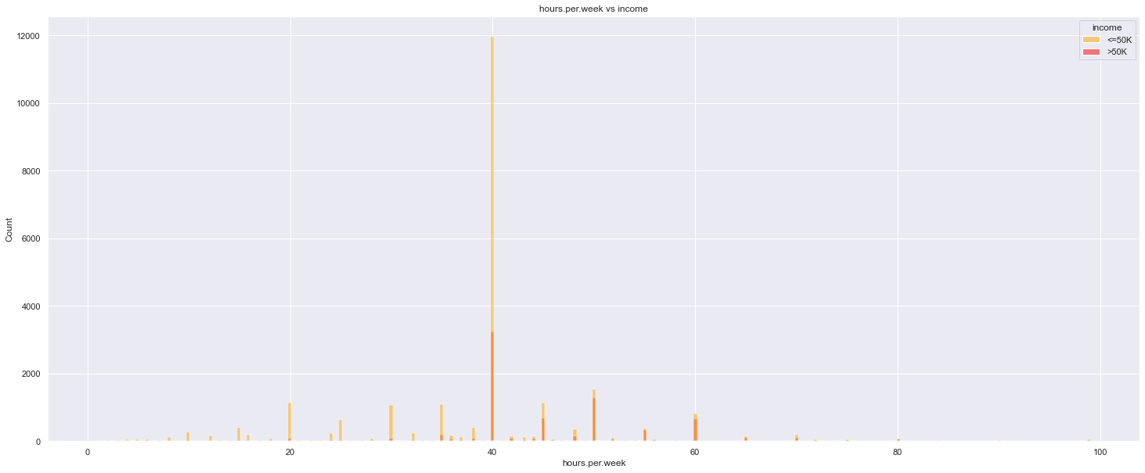
Fig shows that the percentage of individuals making over >50K drastically decreases when less than 40 hours per week, and increases significantly when greater than 40 hours per week.

Slide 13
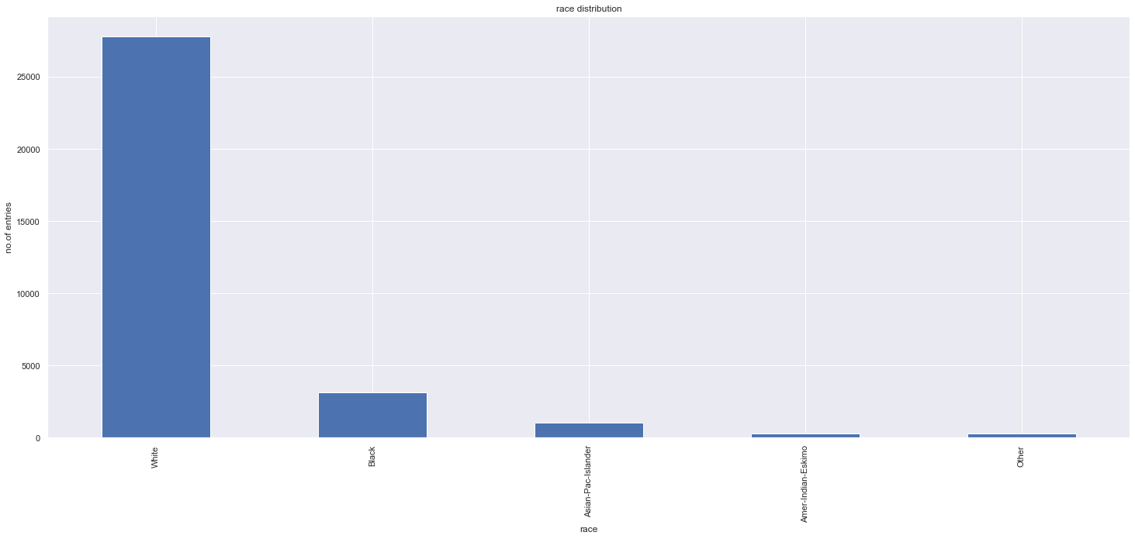
Race distribution

Slide 14
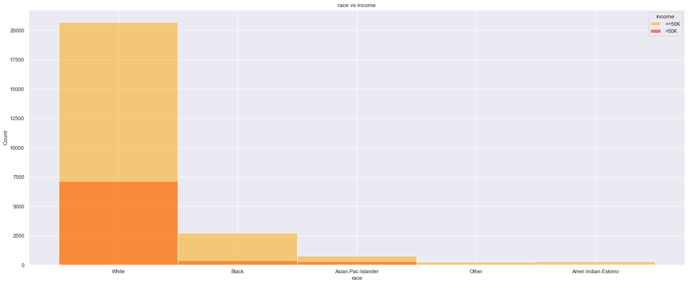
Fig shows, it seems like the feature could be useful in our prediction model, as Whites and Asians have a larger percentage of entries >50K than the rest of the races. However, the sample size of Whites in the dataset is disproportionately large in comparison to all other races. The second most represented group is Blacks with less than 5000 entries. The lack of equal distribution caused us to consider not utilizing this attribute in our prediction model.

Slide 15
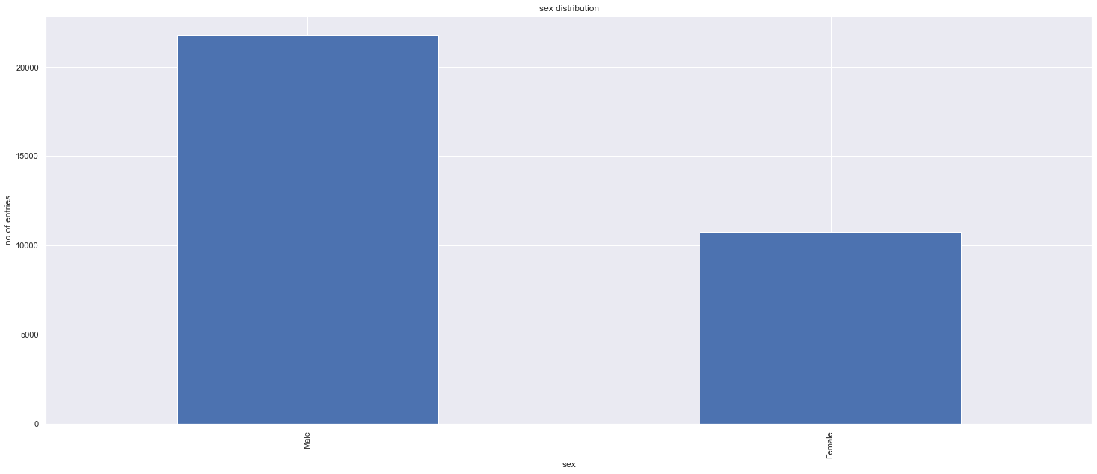
sex distribution
Fig shows, we can see that there is almost double the sample size of males in comparison to females in the dataset. While this may not affect our predictions too much, the distribution of income can.

Slide 16
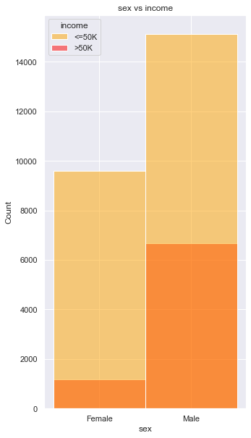
Fig shows, the percentage of males who make >50K is much greater than the percentage of females that make the same amount. This will certainly be a significant factor, and should be a feature considered in our prediction model.

Slide 17
Thank you

